Slide 1
7
Chapter
Managing Change and Innovation

Slide 2
What Is Change and How Do Managers Deal with It?
Organizational Change is a reality of life. Managers, at one point or another, will have to make substantial changes.
  Any alteration of an organization’s people, structure, or technology
  cause stress and counter resistance in the workplace

Slide 3
What External Forces Create a Need to Change?
Both external and internal forces constrain managers, and bring about the need for change
The external forces that create the need for organizational change come from sources
  Marketplace
  Newly emerging technology
  Government laws and regulations
  Economy
  Labor markets..

Slide 4
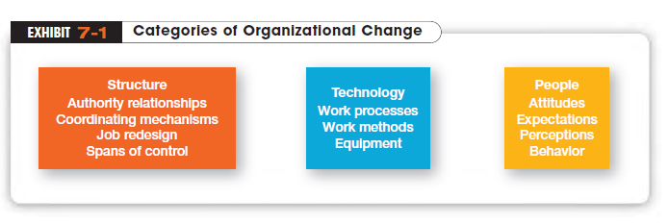

Slide 5
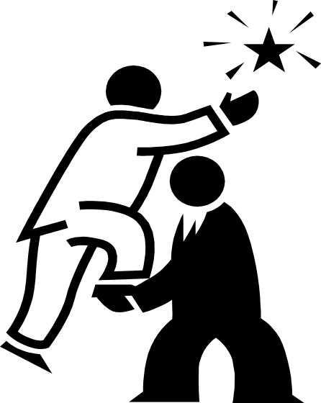
Who Initiates Organizational (Planned) Change?
Organizational changes need a catalyst.
Change Agents
  People who act as change catalysts and assume the responsibility for managing the change process

Slide 6
Change Metaphors
Until recently, the “Calm Waters” metaphor of change dominated the thinking of practicing managers and academics.
  Likens organizational change to a large ship making a predictable trip across a calm sea and experiencing an occasional storm
The prevailing model for handling change in such circumstances ideas, and knowledge is best illustrated in Kurt Lewin’s three-step description of the change process.

Slide 7
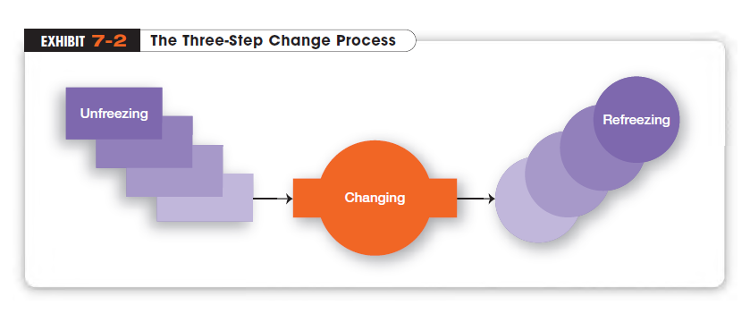
Kurt Lewin’s a contribution was about the dynamics of group decision making and changes are more readily accepted when people felt that they had an opportunity to be involved than they were simply asked or told to change.

Slide 8
From the Past to the Present
“If you want truly to understand something, try to change it.” Kurt Lewin, who’s often called the father of modern social psychology, made his name in management circles through his studies of group dynamics. His approach was based on the belief that “group behavior is an intricate set of symbolic interactions and forces that not only affect group structure but also modify individual behavior.”
Do you like to participate in decision-making? Why or why not?
Lewin’s findings suggested that changes would be more readily accepted when people felt they had an opportunity to be involved in the change rather than when they were simply asked or told to change. One of his research studies found that “changes were more easily induced through group decision making than through lectures and individual appeals.” Another of his major contributions was the idea of force field analysis, a framework for looking at the factors (forces) that influenced a situation.
What implications does Lewin's research have for today's managers?

Slide 9
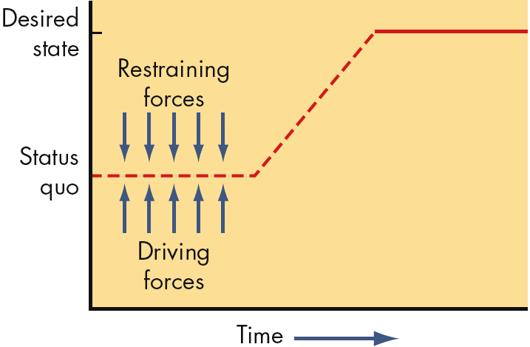
Force Field Analysis (Lewin)
Driving Forces
    Forces that direct behavior away from the status quo
    increasing pay, liberal moving expenses
Restraining Forces
    Forces that hinder movement from the existing equilibrium cab be decreased
    individual counseling to reduce fear

Slide 10
Change Starts a Chain of Events
An oil company’s headquarters in North-West US decides to consolidate divisional offices in South-East into a single regional office.
The reorganization meant transferring more than 150 employees, eliminating some duplicate managerial positions, instituting new hierarchy of command.
The people affected had no say whatsoever, but were expected to move to another city, pulling youngsters out of school, making new friends, having new coworkers, undergoing reassignment of responsibilities.
The only alternative course was to resign; fewer than 10% did!

Slide 11

More recently..
“White-Water Rapids” metaphor of change
  Likens organizational change to a small raft navigating a raging river
  and travelling at night !
  White-water metaphor is consistent with a world that’s increasingly dominated by information, ideas and knowledge.
  In this era, change has to be perceived as a natural state and managing change is a continual process.

Slide 12
How Do Organizations Implement Planned Changes?
Whatever happens—in terms of structure or technology—ultimately affects organizational members.
Organization Development (OD)
  Efforts to assist organizational members with a planned change by focusing on their attitudes and values
  Popular OD efforts in organizations rely heavily on group interactions and cooperation

Slide 13
Organizational Development Activities
Survey feedback
  A method of assessing employees’ attitudes toward and perceptions of a change
  how they view decision making, leadership, communication effectiveness, satisfaction, etc.
Process Consultation
  Using outside consultants to assess organizational processes such as workflow, informal intra-unit relationships, and formal communication channels

Slide 14
OD Activities (cont.)
Team-Building
  Using activities to help work groups set goals, develop positive interpersonal relationships, and clarify the roles and responsibilities of each team member → group become more cohesive
Intergroup Development
  Activities that attempt to make several work groups more cohesive
  attempts to change attitudes, stereotypes, and perceptions that a group may have toward another

Slide 15
Sensitivity Training
  Training groups (T-groups) that seek to change behavior through unstructured group interaction
  Provides increased awareness of others and self
  Increases empathy with others, listening skills, openness, and tolerance for others

Slide 16
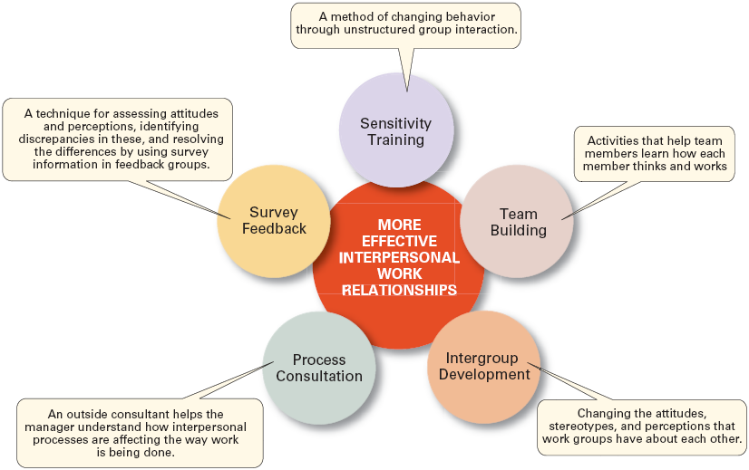
Popular OD Techniques

Slide 17
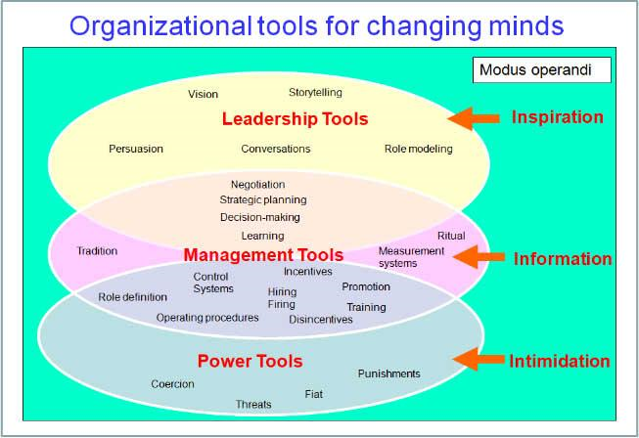
Notes:
Fiat: Order

Slide 18
Why Do People Resist Organizational Change?
  Change replaces the known with uncertainty
  We do things out of habit
  Fear of losing something already possessed
  the belief that the change is not in the organization’s best interest

Slide 19
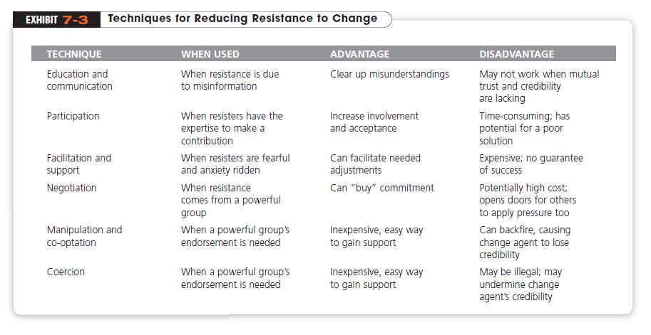
When managers see resistance to change as dysfunctional, what can they do? Several strategies have been suggested:

Slide 20
Change Can Be an Outcome of Innovation
Organizations in complex environments thrive by innovating in technologies, strategies and business models.
Innovative organizations
  actively promote the training and development of their members so their knowledge remains current
  offer their employees high job security to reduce the fear of getting fired for making mistakes.

Slide 21
How Can Managers Encourage Innovation?
Creativity
  The ability to combine ideas in a unique way or to make unusual associations between ideas
  A creative organization develops unique ways of working or novel solutions to problems.
Innovation
  The process of taking a creative idea and turning it into a useful product, service, or method of operation

Slide 22
Fostering Innovation
encourage individuals to become Idea Champions
  Individuals who actively and enthusiastically support new ideas, build support for, overcome resistance to, and ensure that innovations are implemented
Copyright ©2011 Pearson Education

Slide 23
Innovative cultures are generally depicted as pretty fun.
They're characterized by a tolerance for failure and a willingness to experiment.
They're seen as being psychologically safe, highly collaborative, and nonhierarchical.
And research suggests that these behaviors translate into better innovative performance.

Slide 24
But despite the fact that innovative cultures are desirable, and that most leaders claim to understand what they entail, they are hard to create and sustain.
That's because the easy-to-like behaviors that get so much attention are only one side of the coin.

Slide 25
They must be counterbalanced by some tougher and frankly less fun behaviors:
an intolerance for incompetence,
rigorous discipline,
brutal outspokenness,
a high level of individual accountability,
and strong leadership.
Unless the tensions created by this paradox are carefully managed, attempts to create an innovative culture will fail.

Slide 26
The transformation process requires having the right environment to turn those inputs into innovative products or work methods.
This “right” environment—that is, an environment that stimulates innovation—includes three variables: the organization’s structure, culture, and human resource practices.

Slide 27
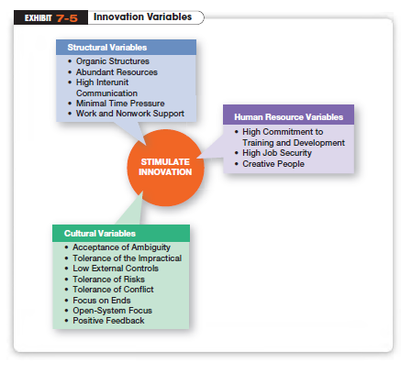

Slide 28
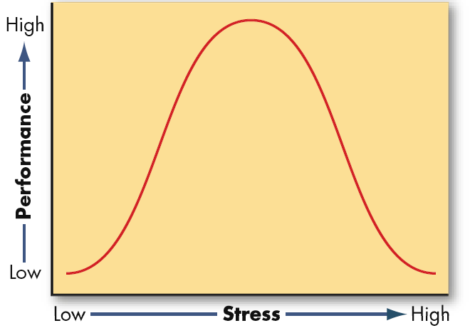
What Is Stress?
The adverse reaction people have to excessive pressure placed on them from extraordinary demands, constraints, or opportunities
  Stress can be positive, especially when it offers a potential gain. For instance, functional stress allow an athlete, stage performer, or employee to perform at his or her highest level at crucial times.

Slide 29
The Ten Most/Least Stressful Jobs
According to Health magazine, the top 10 most and least stressful jobs in US are:
10 Most Stressful Jobs 10 Least Stressful Jobs
1. Inner-city high school teacher 1. Forester
2. Police officer 2. Bookbinder
3. Miner 3. Telephone line worker
4. Air traffic controller 4. Toolmaker
5. Medical intern 5. Millwright
6. Stockbroker 6. Repairperson
7. Journalist 7. Civil engineer
8. Customer service/complaint worker 8. Therapist
9. Secretary 9. Natural scientist
10. Waiter 10. Sales representative
One job that certainly seems like it should be on the list is flight attendant. Planes are more full than ever, passengers are grumpier than ever (due to full planes, smaller seats, more delays), and the pay and job security seems to decline with every passing year. Perhaps none is more stressful than the increasingly tense relationship between passengers and flight attendants, as the job description which used to be all about providing “whatever the passenger wanted.” became “It’s all about telling them what they can and can’t do.”

Slide 30
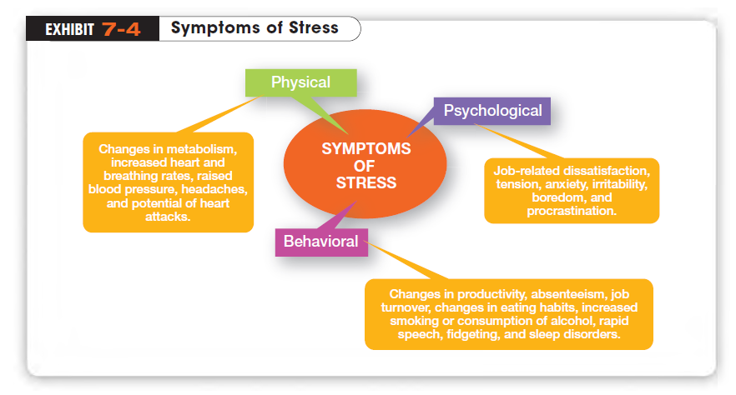

Slide 31
What Causes Stress?
Stressors
  Personal and job-related factors that cause stress
  Change of any kind has the potential to cause stress as it involve demands, constraints, or opportunities
  Karoshi: A Japanese term that refers to a sudden death caused by overworking
Role Conflicts
  Work expectations that are hard to reconcile or satisfy

Slide 32
Stressors (cont.)
Role Overload
  Having more work to accomplish than time permits
Role Ambiguity
  When role expectations are not clearly understood and the employee is not sure what he or she is to do.

Slide 33
Personal Traits
Evidence also indicates that personalities have an effect on how susceptible one is to stress.
Type A Personality
  have a chronic sense of urgency and an excessive competitive drive, and difficulty accepting and enjoying leisure time.
Type B Personality
  more relaxed and easygoing and accept change easily; often are the ones that make it to the top
Notes:
The opposite of Type A is Type B personality. Type Bs never suffer from time urgency or impatience. Until quite recently, it
was believed that Type As were more likely to experience stress on and off the job

Slide 34
How to Deal with Stress?
Not all stress is dysfunctional. Since stress can never be totally eliminated from a person’s life, managers want to reduce the stress that leads to dysfunctional work behavior.
Employee Assistance Programs (EAPs)
  offered by organizations to help employees overcome personal and health related problems
Wellness Programs
  offered by organizations to help employees prevent health problems

Slide 35
Succeeding in mangement today requires good people skillls.
“.. students may get by on their technical and quantitative skills the first couple of years out of school. But soon, leadership and communication skills come to the fore in distinguishing the managers whose carriers really take off.”
    MIT, Sloan School of Management’s Dean

